Slide 1

天父的爱
Father’s Love

Slide 2


天父 你的爱 比天高 比海深
天父 你的爱 是无条件的愛
Father, your love is deeper than the ocean and higher than the sky
Your love is unconditional

Slide 3

天父 你的爱 比天高 比海深
天父 你的爱 是无条件的愛
Father, your love is deeper than the ocean and higher than the sky
Your love is unconditional

Slide 4

无论我有多软弱 你总不撇下我
无论我痛苦挫败 你总关心我
No matter how weak I am, you I will never leave me
Whenever I feel painful and defeated, you care about me

Slide 5

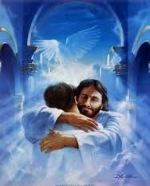
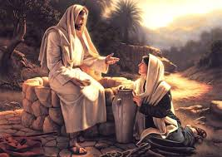
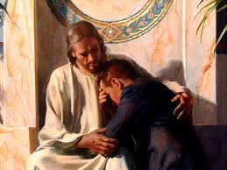
天父 我深信 你接纳这真的我
Father, I deeply believe that you accept this real me

Slide 6
天父爱你
Heavenly Father Loves You
他接纳真的你
He Accepts the Real You

Slide 7
天父 你的爱 比天高 比海深
天父 你的爱 是无条件的愛
Father, your love is deeper than the ocean and higher than the sky
Your love is unconditional

Slide 8
无论我有多软弱 你总不撇下我
无论我痛苦挫败 你总关心我
No matter how weak I am, you I will never leave me
Whenever I feel painful and defeated, you care about me

Slide 9

天父 我深信 你接纳这真的我
Father, I believe deeply that you accept this real me

Slide 10

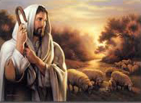


天父 因你爱 我決定将心归你
Father, because of your love, I’ve decided to give my heart to you

